Slide 1
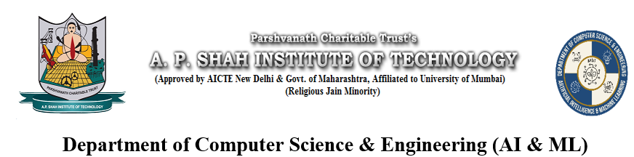
Disease Prediction using Machine Learning
Made by
Sarang Sawant 22106080
Pratik Redekar 22106029
Rohan Patil 22106044
Project Guide
Prof.Monali Korde

Slide 2
Outline
Introduction
Literature Survey of the Existing Systems
Limitations of the Existing Systems
Problem Statement
Block Diagram
Technologies Stack for Proposed System
Implementation
Conclusion
References

Slide 3

Introduction
In today's fast-paced world, timely diagnosis and treatment of diseases are crucial for effective healthcare. This project aims to develop a Disease Prediction System that utilizes machine learning algorithms to analyze user-provided symptoms and predict potential diseases. The system incorporates three powerful models: Decision Tree, Naive Bayes, and Random Forest, to ensure accurate predictions.

Slide 4
Literature Survey of the existing system
1. “Ensemble Learning for Disease Prediction: A Review"
Authors: Syed Muhammad Anas, Muhammad Awais Saleem, Muhammad Bilal, Muhammad Farhan, Yasir Mehmood, Muhammad Salman Rasheed
Publication Date: June 2023
Source: MDPI Healthcare
This paper reviews the use of ensemble learning techniques like bagging, boosting, stacking, and voting for predicting diseases such as diabetes, skin diseases, kidney disease, liver disease, and heart conditions. It highlights stacking as the most accurate ensemble approach in many cases.
2. "A Machine Learning Approach for Predicting Disease Outbreaks"
Authors: J. Zhou, J. Zhang, S. Liu, and others
Publication Date: February 2020
Source: IEEE Xplore
This paper presents a machine learning-based framework for predicting disease outbreaks using historical and real-time data. It discusses the implementation of different machine learning models for early detection and prevention.

Slide 5
3. "Machine Learning in Predicting Chronic Diseases: A Systematic Review"
Authors: R. D. Alzubaidi, L. Al-Dubaiby, A. Alrashed, M. Hussein
Publication Date: December 2020
Source: ScienceDirect
This review systematically evaluates the application of machine learning techniques in predicting chronic diseases like diabetes, hypertension, and heart disease. It also discusses the challenges and future directions in this domain.
4. "Hybrid Machine Learning Models for Disease Prediction"
Authors: A. Sharma, S. Agarwal, R. Patnaik
Publication Date: October 2020
Source: SpringerLink
This paper explores the use of hybrid models, combining different machine learning techniques, to improve the accuracy of disease prediction systems. It covers a range of diseases including diabetes, heart disease, and cancer.

Slide 6
Limitations of Existing Systems
Long assessment time – Traditionally Person need to wait for doctor.
Accessibility : Some times doctors are not available.
Cost : High expenses of physically visiting clinic.

Slide 7
Problem statement
Many people struggle to get quick and accurate diagnoses for their health issues based on their symptoms. Traditional methods can take a lot of time and rely heavily on doctors’ experience. This project aims to create a Disease Prediction System that helps users find out what disease they might have based on the symptoms they enter. By using three different methods—Decision Tree, Naive Bayes, and Random Forest—the system will provide accurate predictions and valuable health information. The goal is to help people get faster and better insights into their health, leading to earlier detection and treatment of illnesses.

Slide 8
Block Diagram
Raw
Data
Data Pre-processing
Processed Data
Decision Tree
Random Forest
Naive Bayes
User Input Data
Data Mapping
Prediction

Slide 9
Technology Stack for Proposed System
Languages:
Python
HTML and CSS
Framework and Libraries:
Flask
Scikit-learn
Numpy
Pandas

Slide 10

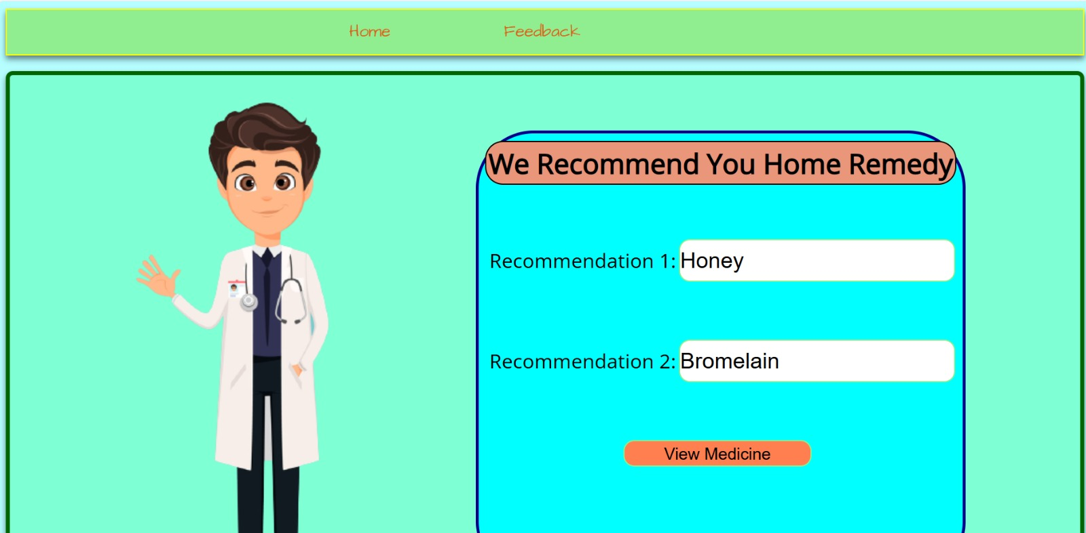
Implementation:

Slide 11
Conclusion
This project demonstrated the effectiveness of Decision Tree, Naive Bayes and Random Forest algorithms in disease prediction, each offering unique strengths. Effective data integration and preprocessing enhanced model accuracy and usability. The developed framework supports practical healthcare integration, improving diagnostic tools for providers and offering early intervention for patients. Future work will focus on exploring advanced techniques, expanding data sources, and ensuring system scalability. These advancements promise significant improvements in healthcare diagnostics and patient outcomes.

Slide 12
References
J. Xie, L. Zhang, and Z. Liu, "A Deep Learning Model for Predicting Disease Risk Using Electronic Health Records," IEEE Transactions on Biomedical Engineering, vol. 71, no. 8, pp. 2345-2356, 2024.
A. Gupta, B. Patel, and C. Sharma, "Improving Disease Prediction Accuracy with Hybrid Machine Learning Techniques," Journal of Biomedical Informatics, vol. 114, pp. 103-112, 2023.
R. Singh, M. Kumar, and S. Mehta, "Comparison of Machine Learning Algorithms for Predictive Analytics in Healthcare," International Conference on Data Mining, IEEE, pp. 678-685, 2022.
L. Chen, H. Yang, and T. Zhou, "A Review of Machine Learning Techniques for Disease Prediction," ACM Computing Surveys, vol. 54, no. 2, pp. 1-34, 2021.
M. Wong and P. Lee, "Ensemble Methods in Disease Prediction: A Comparative Study," Springer Journal of Medical Systems, vol. 44, no. 5, pp. 89-101, 2020.
S. Kumar, A. Sharma, and V. Jain, "Application of Decision Trees for Disease Classification in Medical Data," International Conference on Machine Learning, ACM, pp. 123-130, 2018.

Slide 13
Thank You...!!

